Slide 1
Mobility Models for UAV Group Reconnaissance Applications
By Hayley Paziewski, Jérémy Etcheverry, Alexis Tessier, Mickaël Testa &
Castagnet Florian
26/11/2013
Notes:
<numéro>

Slide 2

Problematic
- Use mobility model that most closely matches the results of real-world scenario.
Master 2 – Computer Science – Authors : fcastagn, jetcheve, hpaziews, atessie & mtesta
- <numéro> -
Notes:
<numéro>

Slide 3
Introduction
MANET
Mobile Ad Hoc Network
Networks of mobile entities
Collect, process and transmit data
UAV
Application of mobility models with UAVs
2 differents mobility models
Random Waypoint
Distributed Pheromone Repel
Master 2 – Computer Science – Authors : fcastagn, jetcheve, hpaziews, atessie & mtesta
- <numéro> -
Notes:
<numéro>

Slide 4
Scenarios
Objectives
Scan area in a limited time
Scan the entire area regularly, but at least once every hour
Characteristics
Square with a side length of 30 Km
10 UAVs per run
Fixed wing aircraft
UAVs start at the middle of south edge
Master 2 – Computer Science – Authors : fcastagn, jetcheve, hpaziews, atessie & mtesta
- <numéro> -
Notes:
<numéro>

Slide 5

Scenarios
Requirements
UAVs are autonomous
Regularly scans
Randomness element in mobility models
Data must be returned to the C&C
Lost or unaivalable UAVs is not important
Communication bandwidth is limited
Master 2 – Computer Science – Authors : fcastagn, jetcheve, hpaziews, atessie & mtesta
- <numéro> -
Notes:
<numéro>

Slide 6
Models
Properties
Min an Max air speed and can’t changed direction in an instant
No collisions thanks to altitude adjustements
Flight altitude: 3500 meters (11 000 feet)
Flight speed: 150 km/h (41.7 m/s, 81.0 knots)
Turn radius: 500 meters
Infinite bandwidth between 2 UAV’s within 8000m
Scan zone 2000x1000 m
Master 2 – Computer Science – Authors : fcastagn, jetcheve, hpaziews, atessie & mtesta
- <numéro> -
Notes:
<numéro>

Slide 7
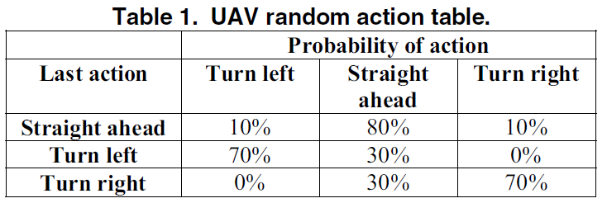
Models
Random Mobility Model
Master 2 – Computer Science – Authors : fcastagn, jetcheve, hpaziews, atessie & mtesta
- <numéro> -
Notes:
<numéro>

Slide 8
Models
Pheromone models
One pheromone map per UAV
Marks the areas when they have been scanned
Broadcast regularly a local area pheromone map
Master 2 – Computer Science – Authors : fcastagn, jetcheve, hpaziews, atessie & mtesta
- <numéro> -
Notes:
<numéro>

Slide 9
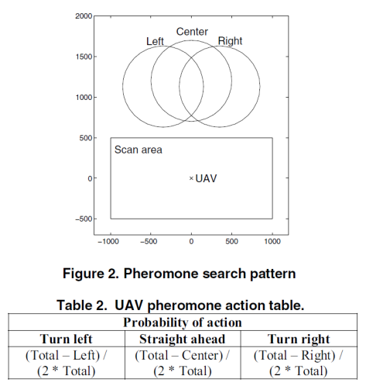
Models
Pheromone models
Master 2 – Computer Science – Authors : fcastagn, jetcheve, hpaziews, atessie & mtesta
- <numéro> -
Notes:
<numéro>

Slide 10
Evaluations
Scan coverage
Scan charateristic
Communication
Master 2 – Computer Science – Authors : fcastagn, jetcheve, hpaziews, atessie & mtesta
- <numéro> -
Notes:
<numéro>

Slide 11
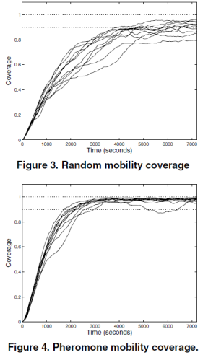
Evaluations
Scan Coverage
Theory : 900km² in 18 min
Prevision : 40 min because of several turnings
Rapidity of scanning : 0,083 km²/s per UAV
Master 2 – Computer Science – Authors : fcastagn, jetcheve, hpaziews, atessie & mtesta
- <numéro> -
Notes:
<numéro>

Slide 12
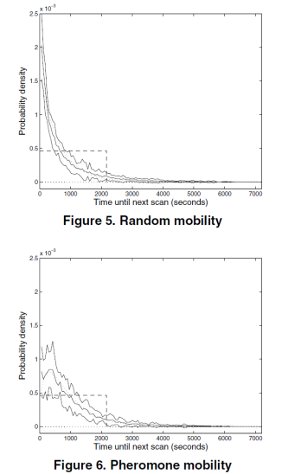
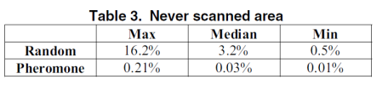
Evaluations
Scan characteristic
Both models manage quite well to avoid rescanning a recently scanned area
Pheromone > Random
Master 2 – Computer Science – Authors : fcastagn, jetcheve, hpaziews, atessie & mtesta
- <numéro> -
Notes:
<numéro>

Slide 13
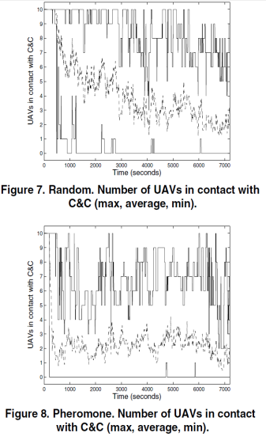
Evaluations
Communication
Low constant connectivity
More UAVs for a fully network connected
Master 2 – Computer Science – Authors : fcastagn, jetcheve, hpaziews, atessie & mtesta
- <numéro> -
Notes:
<numéro>

Slide 14

Conclusion
Pheromone model good scan bad connectivity
Master 2 – Computer Science – Authors : fcastagn, jetcheve, hpaziews, atessie & mtesta
- <numéro> -
Notes:
<numéro>

